Slide 1
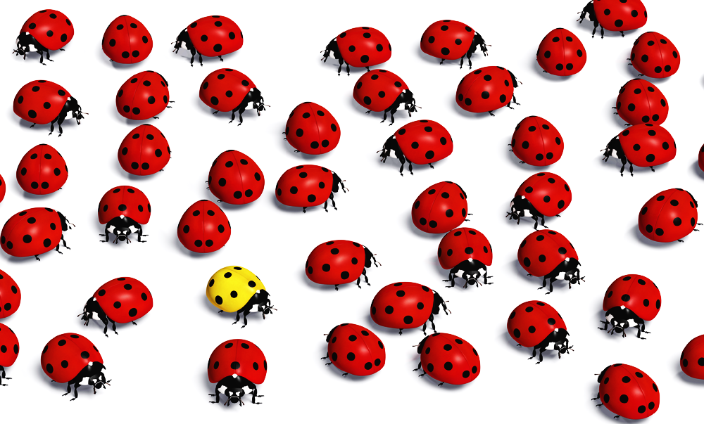
Deviance & Social Control
Ms. Kauser Malik
Lecturer (Psychology)
Sciences and Humanities

Slide 2
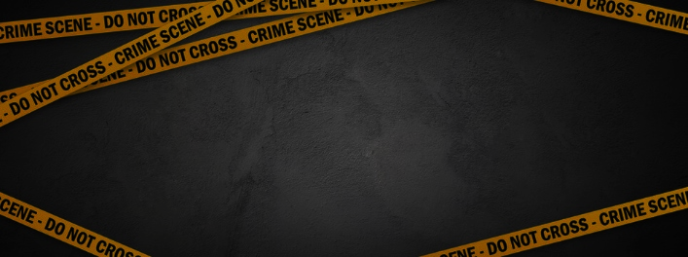
Learning Outcomes
Defining Conformity, Deviance, the need for Norms, Sanctions
Sociobiological, Psychological, and Sociological explanations of deviance
Different perspective related to deviance
1) Symbolic Interactionist Perspective
2) Functionalist Perspective
3) Conflict Perspective

Slide 3
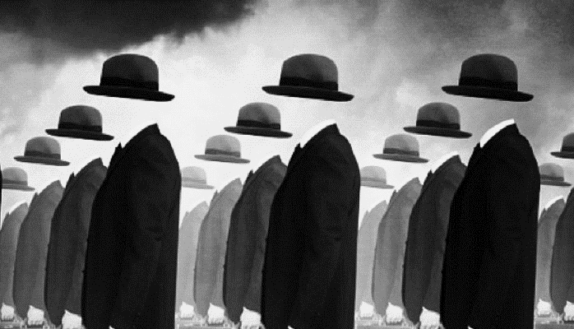
Conformity
Notes:
https://2012books.lardbucket.org/books/sociology-brief-edition-v1.1/s08-deviance-crime-and-social-cont.html

Slide 4
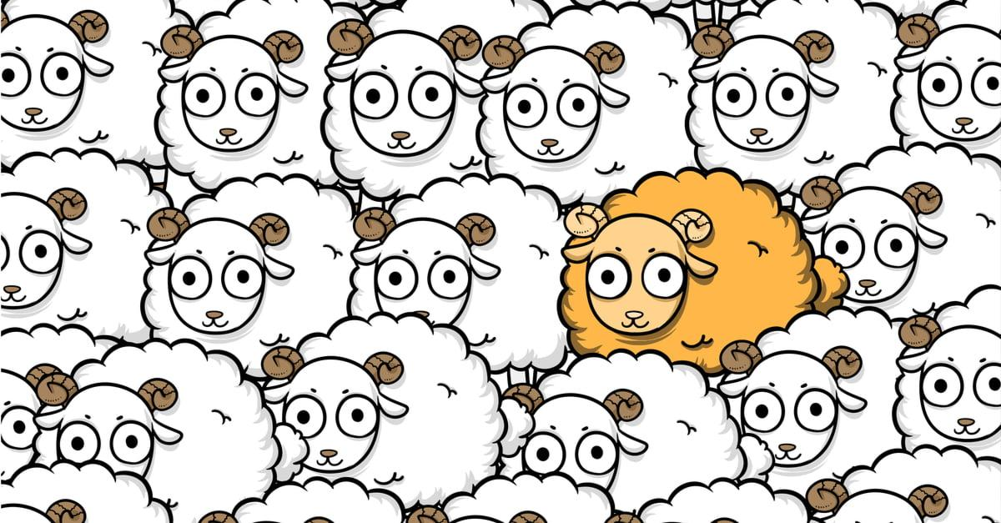
The process whereby people change their beliefs, attitudes, actions, or perceptions to more closely match those held by groups to which they belong or want to belong or by groups whose approval they desire.
Conformity is the act of changing your behaviors in order to fit in or go along with the people around you. No culture or society has complete behavioral conformity.
Examples
Wearing certain types of clothing to fit in with a group
Changing your political beliefs to match those of your friends or family
Going along with the crowd even if you don't agree with what they're doing.

Slide 5
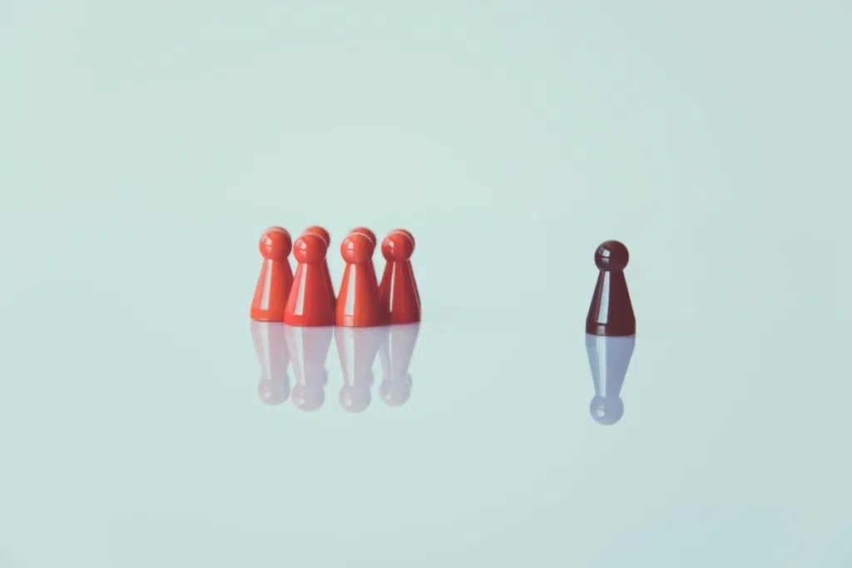
Deviance

Slide 6
Listening to your iPod on the way to class is considered acceptable behavior.
Listening to your iPod during your 2 p.m. sociology lecture is considered rude.
Listening to your iPod when on the witness stand before a judge may cause you to be held in contempt of court and consequently fined or jailed.
Deviance is a socially defined construct that refers to any action, belief, or human characteristic that members of a society or a social group consider a violation of group norms for which the violator is likely to be censured or punished. It refers to any violation of norms, whether the infraction is as minor as driving over the speed limit, as serious as murder.
Behavior that violates the standards of conduct or expectations of a group or society and arouses negative social reactions. Deviance exists in all societies.
Norm violations only become deviance when they exceed the tolerance level of the community and bring negative sanctions. Deviance is behavior of which others disapprove to such an extent that they believe something significant ought to be done about it.

Slide 7
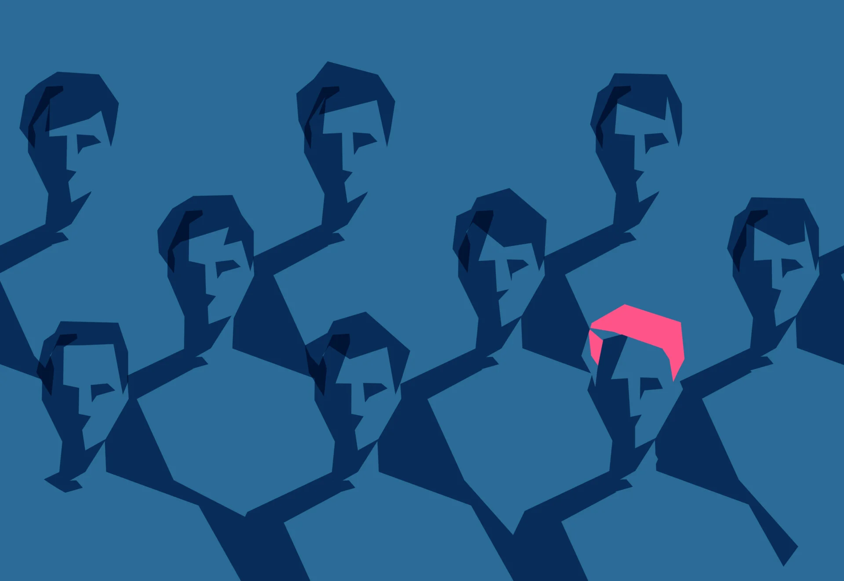
Deviance involves the violation of group norms, which may or may not be formalized into law. It is a comprehensive concept that includes not only criminal behavior but also many actions that are not subject to prosecution.
Deviation from norms is not always negative. E.g., a member of an exclusive social club who speaks out against a traditional policy of not admitting women, Blacks, is deviating from the club’s norms. So is a police officer who blows the whistle on corruption or brutality within the department.
For sociologists, the term deviance does not mean perversion or depravity. In the US, alcoholics, compulsive gamblers, and the mentally ill would all be classified as deviants. Or a public official who takes a bribe has defied social norms, but so has the high school student who refuses to sit in an assigned seat or cuts class.

Slide 8
What is important about deviance?
Deviance is Universal
It exists in all societies.
Deviance is Variable
Any act or person may or may not be labeled deviant.
Deviance is Political
People with little power are at high risk of being labeled deviant.
Deviance is a means of Control
Dominant categories of people discredit others as a means to dominate them.

Slide 9
The Relativity of Deviance
Deviance is relative: there is no absolute way of defining a deviant act, vary across societies and from one group to another within the same society.
Defining deviance as behavior of which others disapprove has an interesting implication: It is not the act that is important but the audience. Sociologically, no act, belief, or characteristic is inherently deviant because deviance is socially defined. According to sociologist Howard S. Becker (1966), “It is not the act itself, but the reactions to the act, that make something deviant.”
Because different groups have different norms, what is deviant to some is not deviant to others. This principle applies not just to cultures but also to groups within the same society. Deviance is so relative that what is deviant in one group may be conformist in another. Because of this, deviance must be considered from within a group’s own framework: It is their meanings that underlie their behavior.

Slide 10
Also applies to norms of sexuality. Norms of sexual behavior vary so widely around the world that what is considered normal in one society may be considered deviant in another.
Applies to crime as well (the violation of rules that have been written into law). An act that is applauded by one group may be so despised by another group that it is punishable by death.
Time and space: Today’s deviance, declared Durkheim, can become tomorrow’s morality. What is thought to be deviant will vary from one time period to another. Some behaviors were once not seen as deviant but now are (for example, obesity) while other behaviors were once seen as deviant but now are not (for example, premarital sex). What is thought to be deviant will also vary geographically. Tattoos, vegan lifestyles, single parenthood, and even jogging were once considered deviant but are now widely accepted.
From a structural functionalist perspective, one of the positive contributions of deviance is that it fosters social change. For example, during the U.S. civil rights movement, Rosa Parks violated social norms when she refused to move to the “black section” of the bus.

Slide 11
How Norms Make Social Life Possible?
Norms make social life possible by making behavior predictable. There will be social chaos without norms.
Norms lay out the basic guidelines for how we should play our roles and interact with others.
In short, norms bring about social order, a group’s customary social arrangements. People’s lives are based on these arrangements, which is why deviance often is perceived as threatening. Deviance undermines predictability, the foundation of social life.

Slide 12
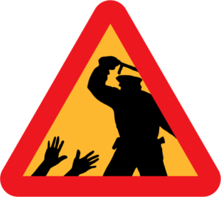
Social Control
Consequently, human groups developed a system of social control—formal and informal means of enforcing norms. At the center of social control are sanctions.
Refers to ways and attempts by society which tries to prevent and sanction behavior that violates its norms.
The underlying goal of social control is to regulate people’s thoughts and behavior, maintain social order, an arrangement of practices and behaviors on which society’s members base their daily lives.
Just as a society has informal and formal norms so does it have informal and formal social control. Informal social control is used to control behavior that violates informal norms, and formal social control is used to control behavior that violates formal norms.

Slide 13
Émile Durkheim stressed that a society without deviance is impossible for at least two reasons:
First, the collective conscience is never strong enough to prevent all rule breaking. Even in a “society of saints,” such as a monastery, he said, rules will be broken and negative social reactions aroused.
Second, because deviance serves several important functions for society, any given society “invents” deviance by defining certain behaviors as deviant and the people who commit them as deviants. Because Durkheim thought deviance was inevitable for these reasons, he considered it a normal part of every healthy society.
Whether a behavior is considered deviant depends on the circumstances in which the behavior occurs and not on the behavior itself.
If an assailant, e.g., a young male, murders someone, he faces arrest, prosecution, and, in many states, possible execution.
Yet if a soldier kills someone in wartime, he may be considered a hero.
Killing occurs in either situation, but the context and reasons for the killing determine whether the killer is punished or given a medal.

Slide 14
Social control leading to Sanctions
The means of enforcing rules are known as sanctions. A sanction is any reaction from others to the behavior of an individual or group. Sanctions can be positive as well as negative. Both types of sanctions play a role in social control. Sanctions are social and psychological penalties and sometimes rewards used to regulate the behaviors of a group or society.
Sociologists also classify sanctions as formal or informal; e.g., picking your nose in public or a smile or pat on the back. Informal sanctions emerge in face-to-face social interactions.
Formal sanctions, on the other hand, are ways to officially recognize and enforce norm violations. If a student violates her college’s code of conduct, for example, she might be expelled. Someone who commits a crime may be arrested or imprisoned. On the positive side, a soldier who saves a life may receive an official commendation.
Social sanctions encourage behaviors that are considered to be appropriate and deter behaviors that are not.

Slide 15
Formal Sanctions
Informal Sanctions
are officially recognized or official punishments or penalties imposed by a social group via its authority figures to enforce social norms and values.
Sanctions that are not legally binding and tend to occur in face-to-face interactions to encourage social norms and values.
E.g., peer pressure, shaming, social ostracisms, bullying
Includes all the formal penalties imposed by society in order to uphold social norms.
Examples: legal penalties, fines, imprisonment, suspension, detention, expulsion, forced community service, and other punishments codified in law or instituted by a recognized authority.

Slide 16
Types of Sanctions
Negative Sanctions
Positive Sanctions
- Punishments for violating norms.
- An expression of disapproval for breaking a norm, ranging from a mild, informal reaction such as a frown to a formal reaction such as a fine or a prison sentence.
- Positive sanctions are rewards given for conforming to norms.
- In general, the more seriously the group takes a norm, the harsher the penalty for violating it.
- Most negative sanctions are informal. E.g.: getting arrested for shoplifting, being fired or getting an F in a course.
- An expression of approval for following a norm, ranging from a smile or a good grade in a class to a material reward such as a prize.
- E.g., getting a raise, scoring an A in a course, promotion at work for working hard.

Slide 17
Competing Explanations of Deviance: Sociobiology
Biosocial Explanations
Sociobiologists explain deviance by looking for answers within individuals. They assume that genetic predispositions lead people to such behaviors as juvenile delinquency and crime (Lombroso 1911; Wilson and Herrnstein 1985; Barnes and Jacobs 2013).
People with “squarish, muscular” bodies were more likely to commit street crime—acts such as mugging, rape, and burglary.
These theories were abandoned as research did not support them.
Genetic Predisposition
Inborn tendencies (for example, a tendency to commit deviant acts) street crime crimes such as mugging, rape, and burglary

Slide 18
Psychological Explanations
Psychologists focus on abnormalities within the individual. Instead of genes, they examine what are called personality disorders. Their supposition is that deviating individuals have deviating personalities (Mayer 2007; Liu 2014) and that subconscious motives drive people to deviance.
Psychologists have shown that personality patterns have some connection to deviance. Some serious criminals are psychopaths who do not feel guilt or shame, have no fear of punishment, and have little or no sympathy for the people they harm (Herpertz & Sass, 2000). More generally, the capacity for self-control and the ability to withstand frustration do seem to be skills that promote conformity.
Deviance and Psychology
The view that a personality disturbance of some sort causes an individual to violate social norms.

Slide 19
Sociological Explanations
In contrast with both socio-biologists and psychologists, sociologists search for factors outside the individual. They look for social influences that “recruit” people to break norms or to account for why people commit crimes. For example, sociologists examine such external influences as socialization, membership in subcultures, and social class.
2. People become deviant as others define them that way. Everyone violates cultural norms at one time or another.
3. How societies set norms and how they define rule breaking both involve social power. The law, declared Karl Marx, is the means by which powerful people protect their interests. Norms and how we apply them reflect social inequality.
1. Deviance varies according to cultural norms. No thought or action is inherently deviant; it becomes deviant only in relation to particular norms. Because norms vary from place to place, deviance also varies. Prostitution, medical and recreational use of marijuana, driving at a particular speed, gambling, text messaging while driving.

Slide 20
To explain deviance, sociologists apply the three sociological perspectives:
Symbolic Interactionism
Functionalism
Conflict Theory

Slide 21
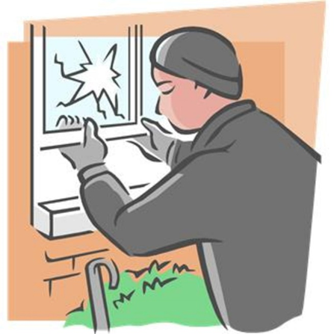
1. Symbolic Interactionist Perspective
The symbolic-interaction approach explains how people define deviance in everyday situations by interpreting them. From this point of view, definitions of deviance and conformity are surprisingly flexible.
Symbolic interactionists focus on group membership (differential association), how people balance pressures to conform and to deviate (control theory), and the significance of reputations (labeling theory).

Slide 22
Labeling Theory (The Significance of Reputations)
The idea that deviance and conformity result not so much from what people do as from how others respond to those actions. Focuses on how and why the label deviant comes to be attached to specific people and behaviors. This theory takes to heart the maxim that deviance is relative.
The view that the labels people are given affect their own and others’ perceptions of them, thus channeling their behavior into either deviance or conformity. The significance of reputations, how reputations or labels help set people on paths that propel them into deviance or divert them away from it.
Labeling theory examines the ascribing of a deviant behavior to another person by members of society. Thus, what is considered deviant is determined not so much by the behaviors themselves or the people who commit them, but by the reactions of others to these behaviors.
Sociologist Edwin Lemert expanded on the concepts of labeling theory and identified two types of deviance that affect identity formation.

Slide 23
Primary deviance
Secondary deviance
a violation of norms that does not result in any long-term effects on the individual’s self-image or interactions with others.
Speeding is a deviant act, but receiving a speeding ticket generally does not make others view you as a bad person, nor does it alter your own self-concept. Individuals who engage in primary deviance still maintain a feeling of belonging in society and are likely to continue to conform to norms in the future.
Sometimes, in more extreme cases, primary deviance can morph into secondary deviance.
Secondary deviance occurs when a person’s self-concept and behavior begin to change after his or her actions are labeled as deviant by members of society. The person may begin to take on and fulfill the role of a “deviant” as an act of rebellion against the society that has labeled that individual as such.
For example, consider a high school student who often cuts class and gets into fights. The student is reprimanded frequently by teachers and school staff, and soon enough, he develops a reputation as a “troublemaker.” As a result, the student starts acting out even more and breaking more rules; he has adopted the “troublemaker” label and embraced this deviant identity.
Secondary deviance can be so strong that it bestows a master status on an individual. A master status is a label that describes the chief characteristic of an individual. Some people see themselves primarily as doctors, artists, or grandfathers. Others see themselves as beggars, convicts, or addicts.

Slide 24
Sutherland’s Differential Association Theory
Differential association theory argues that people learn to be deviant when more of their associates favor deviance than favor conformity. This theory suggests that people who grow up in crime-ridden neighborhoods are more likely to become criminals themselves.
Edwin Sutherland’s term this to indicate that from the different groups we associate with, we learn to deviate from or conform to society’s norms. According to him, a person’s tendency toward conformity or deviance depends on the amount of contact with others who encourage or reject conventional behavior. A number of research studies confirm the idea that young people are more likely to engage in delinquency if they believe members of their peer groups encourage such activity (Akers et al., 1979; Miller & Mathews, 2001).

Slide 25
Family/Friends/Neighborhoods:
Family makes a big difference in whether people learn deviance or conformity. Researchers have confirmed this informal observation. Of the many studies, this one stands out: Of all prison inmates across the United States, about half have a father, mother, brother, sister, or spouse who has served time in prison (Sourcebook of Criminal Justice Statistics 2003:Table 6.0011; Glaze and Maruschak 2008:Table 11). In short, families that are involved in crime tend to set their children on a lawbreaking path.
Most parents want to move out of “bad” neighborhoods because they know that if their kids have delinquent friends, they are likely to become delinquent, too.
If the neighbors feel that a victim deserved to be killed, they refuse to testify because “he got what was coming to him” (Kubrin and Weitzer 2003).
Killing can even be viewed as honorable. How concept of “honor” propels young men to deviance. “A real man has honor. An insult is a threat to one’s honor. Therefore, not to stand up to someone is to be less than a real man.” One might even carry a knife or a gun, because words and fists wouldn’t always be sufficient.
Ideas of masculinity continue to produce high rates of violence, including homicide. Members of the Mafia also intertwine ideas of manliness with killing.

Slide 26
Control Theory
Sociologist Walter Reckless (1973), who developed control theory, stressed that we have two control systems that work against our motivations to deviate.
Our inner controls-include our internalized morality—conscience, religious principles, ideas of right and wrong. Inner controls also include fears of punishment and the desire to be a “good” person (Hirschi 1969; Gottfredson 2011).
Our outer controls- consist of people—such as family, friends, and the police—who influence us not to deviate.
E.g., going to a nightclub - the drug Ecstasy. The pushes and pulls - The pushes toward taking the drug: friends, the setting, and perhaps the curiosity. The inner controls—those inner voices of conscience and parents, perhaps of teachers, as well as the fears of arrest and the dangers of illegal drugs. There are also the outer controls—perhaps the uniformed security guard looking in your direction. Which is stronger: the inner and outer controls or the pushes and pulls toward taking the drug? best weighing these forces, since they differ with everyone. This is the center of what control theory is all about.

Slide 27
2. Functionalist Perspective
Functionalists point out that deviance also has functions. According to classic functionalist theorist Emile Durkheim, deviance, including crime—is functional for society. Deviance contributes to the social order in three ways:
1. Deviance clarifies moral boundaries and affirms norms.
2. Deviance encourages social unity.
3. Deviance promotes social change.
Can Deviance Really Be Functional for Society?
Functionalists stress that just as the social classes differ in opportunities for income and education, so they differ in opportunities for crime. As a result, street crime is greater among the lower social classes and white-collar crime greater among the higher social classes. The growing crime rates of women illustrate how changing gender roles have given women more access to what sociologists call “illegitimate opportunities.”

Slide 28
1. Deviance clarifies moral boundaries and affirms norms
Deviance challenges those boundaries. To call a member into account is to say, in effect, “You broke an important rule, and we cannot tolerate that.” Punishing deviants affirms the group’s norms and clarifies what it means to be a member of the group.
By moral boundaries, Durkheim referred to a group’s ideas about how people should think and act.
2. Deviance encourages social unity
To affirm the group’s moral boundaries by punishing deviants creates a “we” feeling among the group’s members. By saying, “You can’t get away with that,” the group affirms the rightness of its ways.
3. Deviance promotes social change
Deviance, then, may force a group to rethink and redefine its moral boundaries, helping groups and whole societies to adapt to changing circumstances.
Not everyone agrees on what to do with people who push beyond the accepted ways of doing things. Some group members may even approve of the rule-breaking behavior. Boundary violations that gain enough support become new, acceptable behaviors.

Slide 29
3. The Conflict Perspective
Social-conflict approach, links deviance to social inequality. That is, who or what is labeled deviant depends on which categories of people hold power in a society. It also argues that deviance is punished more strictly for those with less power. At the same time, the elite in society is much more likely to get away with crime.
This raises some provocative possibilities for society’s response to deviance and crime:
First, harmful behavior committed by corporations and wealthy individuals may not be considered deviant, perhaps because “respectable” people engage in them.
Second, prostitution and other arguably less harmful behaviors may be considered very deviant because they are deemed immoral or because of bias against the kinds of people (poor and nonwhite) thought to be engaging in them.

Slide 30
Deviance and the Poor
Deviance is created by the capitalist economic system.
Definitions of deviance serve the interest of the capitalists while adversely affecting the poor.
Deviance and the Elite
Great efforts are made by the capitalists to legitimize elite acts of deviance.
The higher-ups in society have greater ability to commit deviant acts, to escape sanction for those acts, and to create scapegoats to blame for those acts.
Conflict theorists stress that the power elite developed the legal system to stabilize the social order. They use it to control the poor, who pose a threat to the powerful. The poor hold the potential of rebelling as a group, which could dislodge the power elite from their place of privilege. To prevent this, the criminal justice system makes certain that heavy penalties come down on the poor.

Slide 31
Hirschi’s Social Control Theory
Hirschi’s social control theory asserts that ties to family, school and other aspects of society serve to reduce the likelihood of an individual participating in deviant This theory suggests that crime occurs when such bonds are weakened or are not well established.
Unlike other theories that seek to explain why people engage in deviant behaviour, control theories take the opposite approach, questioning why people refrain from offending. Social control theory focuses on the role of social and familial bonds as a reason for individuals to refrain from offending. The idea that young peoples behaviour is 'controlled' by the family, particularly through the support (financial & emotional) of their parents. This connection exploits their relationship to explain their conformity. Many studies exploring social control on delinquency shows a correlation between a negative relationship between parent and children and delinquency. As such, it has been found that the greater the attachment to parents, the lower the likelihood of involvement in delinquent behaviour.
As a result, criminality is seen as a possibility for all individuals within society, avoided only by those who seek to maintain familial and social bonds.

Slide 32
Deviance and Power
Alexander Liazos (1972) points out that the people we tend to define as deviants—the ones we dismiss as “nuts” are typically not as bad or harmful as they are powerless. Social-conflict theory explains this pattern in three ways:
First, all norms—especially the laws of any society—generally reflect the interests of the rich and powerful. People who threaten the wealthy are likely to be labeled deviant. Karl Marx argued that the law and all other social institutions support the interests of the rich. Or as Richard Quinney puts it, “Capitalist justice is by the capitalist class, for the capitalist class, and against the working class” (1977:3).
Second, even if their behavior is called into question, the powerful have the resources to resist deviant labels. The majority of the executives involved in recent corporate scandals have yet to be arrested; only a few have gone to jail.
Third, the widespread belief that norms and laws are natural and good masks their political character. For this reason, although we may condemn the unequal application of the law, we give little thought to whether the laws themselves are really fair or not.

Slide 33
Deviance and Capitalism
In the Marxist tradition, Steven Spitzer (1980) argues that deviant labels are applied to people who interfere with the operation of capitalism. On the other side of the coin, society positively labels whatever supports the operation of capitalism. For example, winning athletes enjoy celebrity status because they express the values of individual achievement and competition, both vital to capitalism.
Also, Spitzer notes, we condemn using drugs of escape (marijuana, psychedelics, heroin, and crack) as deviant but encourage drugs (such as alcohol and caffeine) that promote adjustment to the status quo. The capitalist system also tries to control people who are not economically productive. The elderly, people with mental or physical disabilities, and people addicted to alcohol or other drugs are a “costly yet relatively harmless burden” on society.

Slide 34
Second, because capitalism depends on productive labor, people who cannot or will not work risk being labeled deviant.
Third, capitalism depends on respect for authority figures, causing people who resist authority to be labeled deviant. Examples are children who skip school or talk back to parents and teachers and adults who do not cooperate with employers or police.
First, because capitalism is based on private control of wealth, people who threaten the property of others—especially the poor who steal from the rich—are prime candidates for being labeled deviant. On the other hand, the rich who take advantage of the poor are less likely to be labeled deviant. For example, landlords who charge poor tenants high rents and evict anyone who cannot pay are not considered criminals; they are simply “doing business.”
Fourth, anyone who directly challenges the capitalist status quo is likely to be defined as deviant. Such has been the case with labor organizers, radical environmentalists, and antiwar activists.

Slide 35
